Slide 1
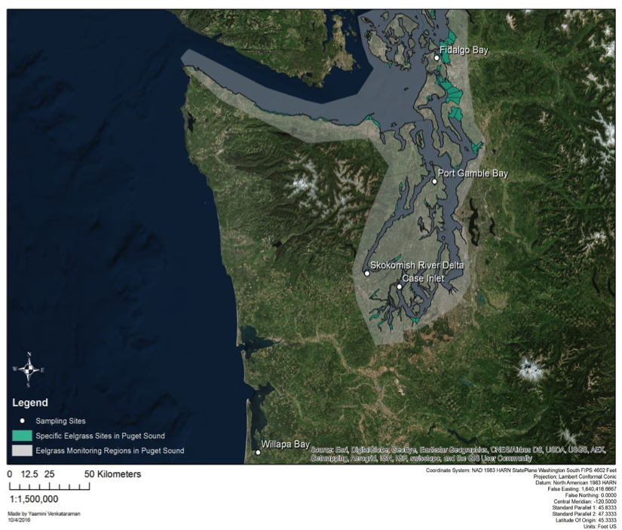
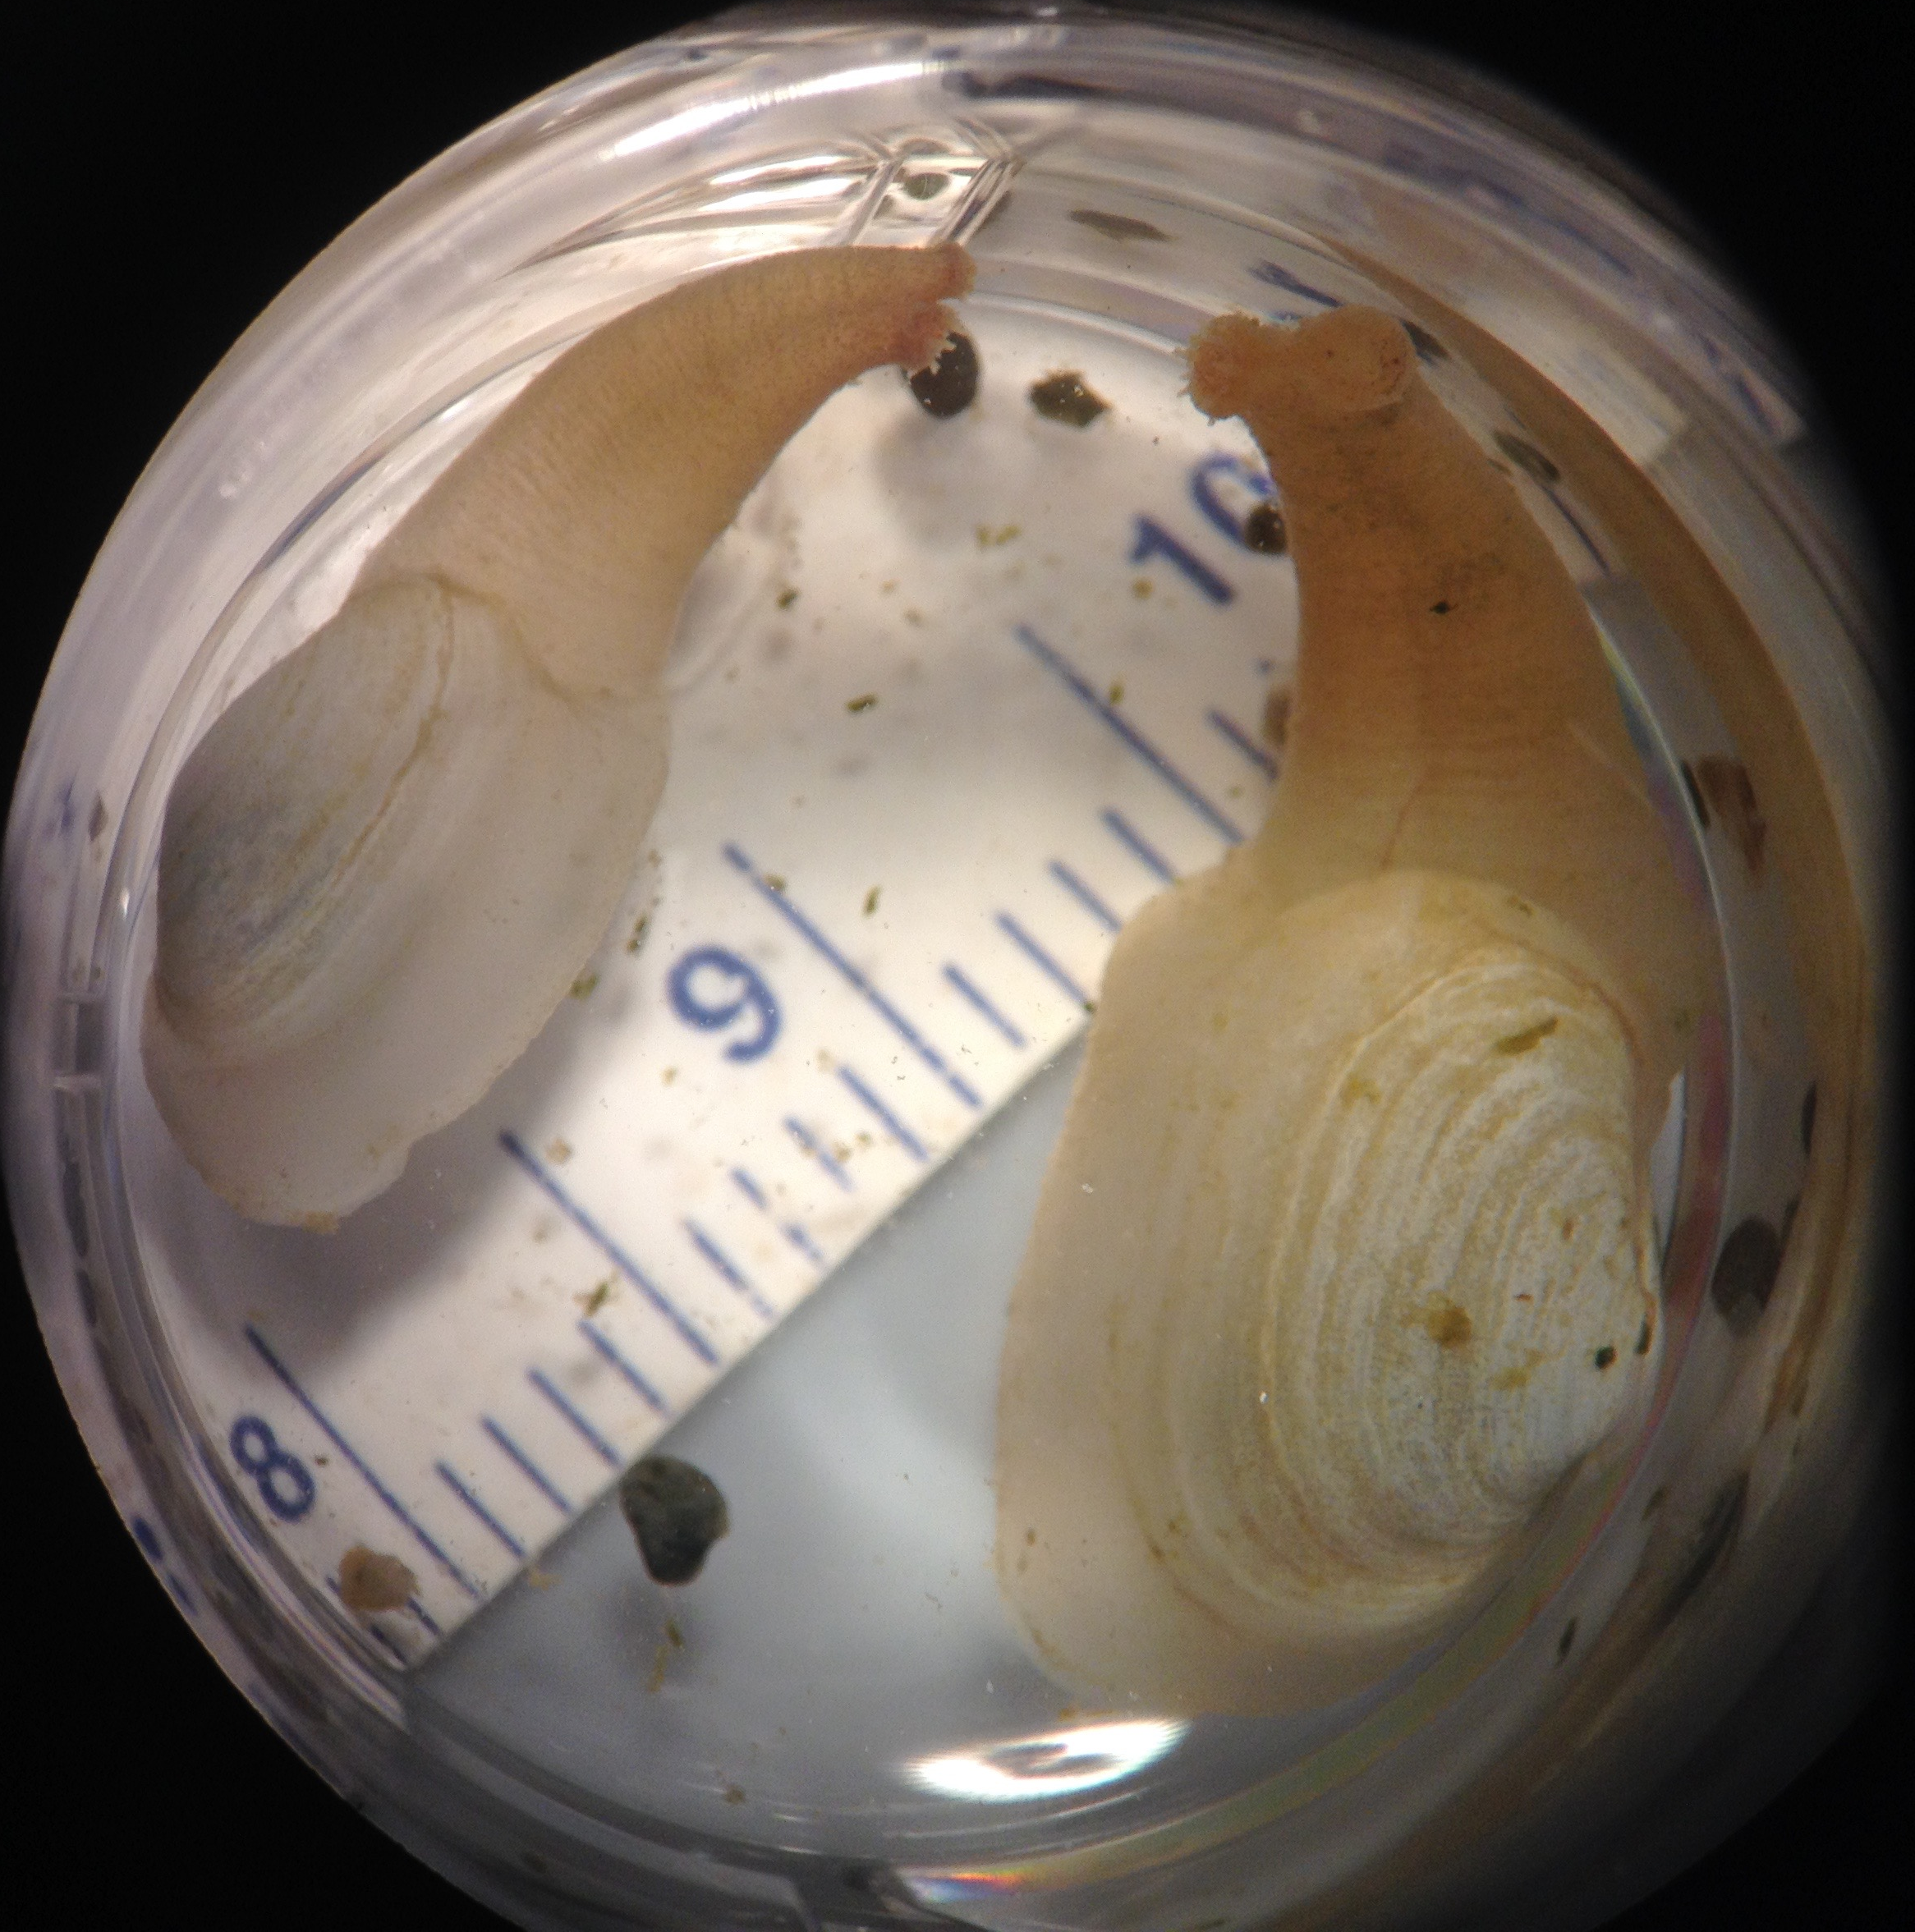
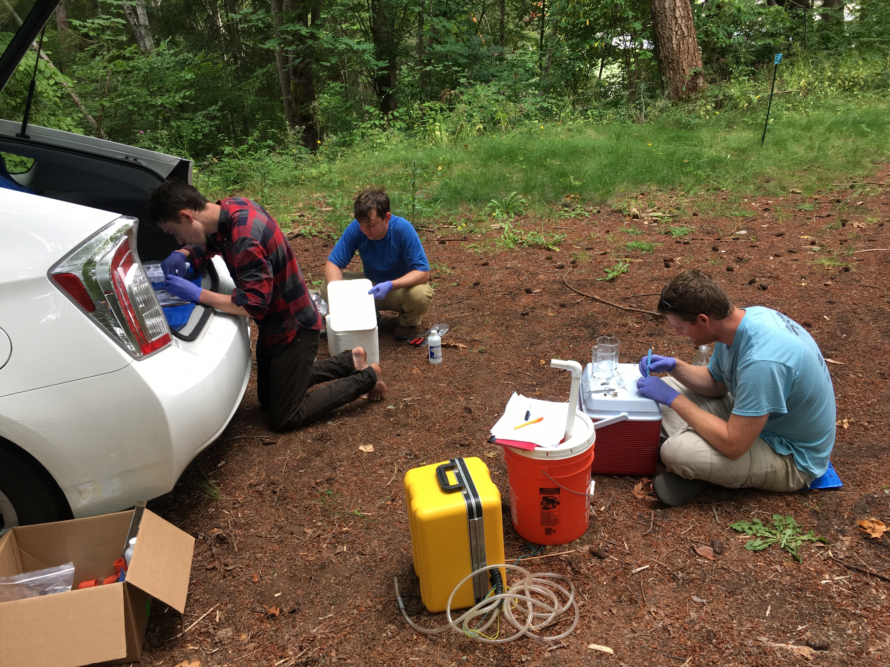
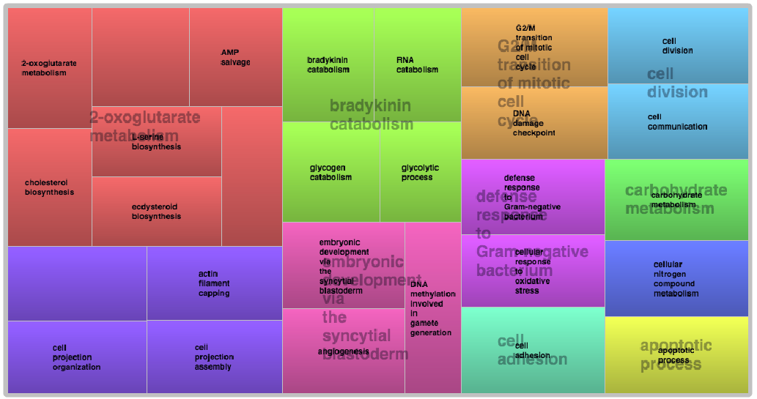
Geoduck as indicators of environmental change
Laura H. Spencer¹, Micah Horwith², Alex Lowe³, Emma Timmins-Schiffman⁴, Brook L Nunn⁴, Steven Roberts¹ [ADD SEAN?]
1: UW SAFS 2: WA DNR 3: UW Biology 4: UW Genome Sciences
The animal
The analysis
The sites
The Pacific geoduck (Panopea generosa) is the largest clam native to the Pacific Northwest and is a burgeoning aquaculture species due to growing export demands from Asia. In Washington State, geoduck support important commercial fisheries via farmed and wild populations in Puget Sound. As a sedentary, calcifying bivalve occupying mostly subtidal sediment, geoduck are likely to be impacted by climate stressors, which have already been documented as trending towards warmer, more acidic marine conditions. Research into how ocean acidification and warming will impact geoduck clams is at a nascent stage.
[insert method used]
Sonication and cell lyses
Protein quantification
Mini-Trypsin digestion
Desalting and peptide isolation
Add standards
5 distinct sites throughout western Washington
Each site with 2 treatments locations: eelgrass bed, bare sediment
Each treatment with four replicates
Continuous water quality measurements via Seabird CTD and Durafet pH Probe to collect: pH, temperature, salinity, depth, chlorophyll
Two 30-day trials in June and August 2016
Gill tissue sampled and frozen on-site for protein extraction
Extract proteins & fragment
Data-Independent Tandem Mass Spectrometry
Orbitrap Fusion Lumos machine
Does not require pre-selected precursor ions
Captures all peptides within designated mass/charge ratio
Identify and quantify peptides
PECAN
Survey peptides against annotated background proteome
Generate summary file for direct use in Skyline
30 days
5 sites
2 treatments per site
-Eelgrass
-Bare
Identify proteins in samples
Quantify relative protein abundance
Skyline
View summary statistics for peptide abundance
Export statistics for processing and visualization
The initial results
The objectives
PRETTY PLOT HERE
Examine how environmental conditions affect the fundamental mechanisms in p. generosa using in situ experimental design and a bottom-up, broad-spectrum protein expression analysis.
Identify differentially expressed proteins in geoduck exposed to different environments, and quantify variability in expression between genotypes and sites.
Explore the potential for eelgrass beds to mitigate the impact of ocean acidification on geoduck and other clams found in coastal and estuarine bays in Washington State.
The questions
Thank you
Can we detect an environmental signature via differential protein expression?
Does treatment correlate with expression of stress-related proteins?
What is the overall variability in protein expression in juvenile geoduck?
Do we see a difference in protein expression between geographical sites?
This project is supported by the National Science Foundation Graduate Research Fellowship Program, in collaboration with the Washington Department of Natural Resources, and the [grant funding for supplies etc?]?
Special thanks to:
Dr. Emma Timmins-Schiffman, Dr. Brook L. Nunn, and the rest of the MacCoss lab of Biological Mass Spectrometry at the University of Washington Department of Genome Sciences.
University of Washington Proteomics Resource
Sean (unless he should be a co-author?)

